Slide 1
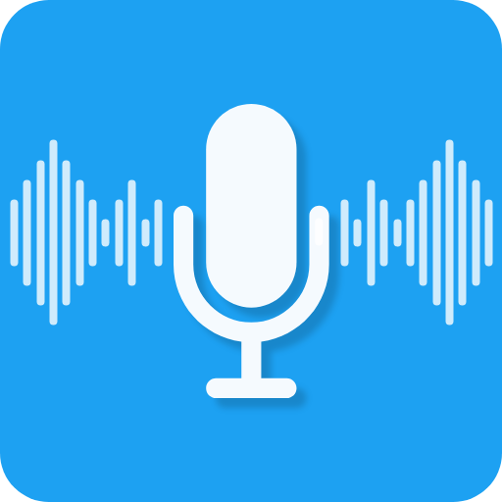
Automated Voice Assistant in Python
Real time research project
TEAM MEMBERS
22C31A6601 - A.SUDHEER KUMAR
22C31A6603- A.SURAJ KUMAR
22C31A6606- A.SAHODAR REDDY
22C31A6650- P.JAYARAM

Slide 2
Introduction
Effortless Task Automation: Perform tasks like Wikipedia searches and playing music with just a voice command
Convenient Browsing: Open web browsers and other applications without lifting a finger.
User-Friendly Design: Built with Python for easy implementation and user interaction.
Natural Language Understanding: Understands and executes commands in natural language.
Versatile and Error-Free: Fully completed, error-free project compiled in VS Code Editor.

Slide 3
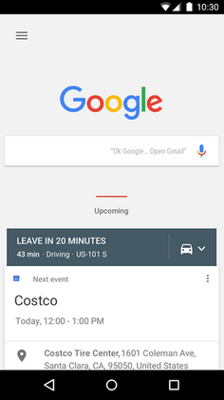
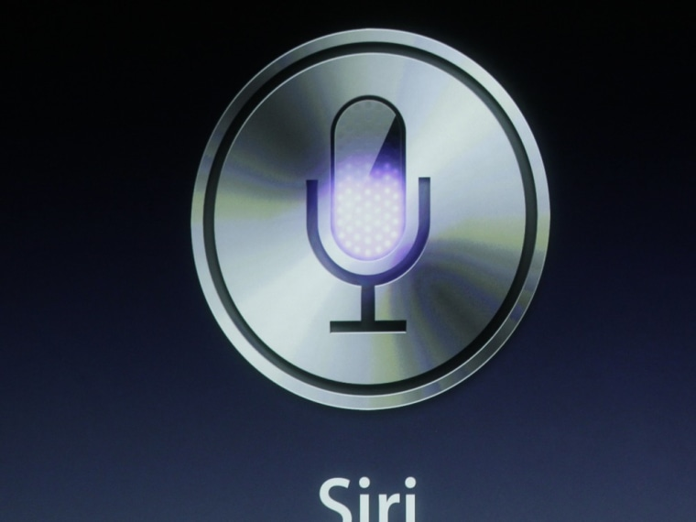
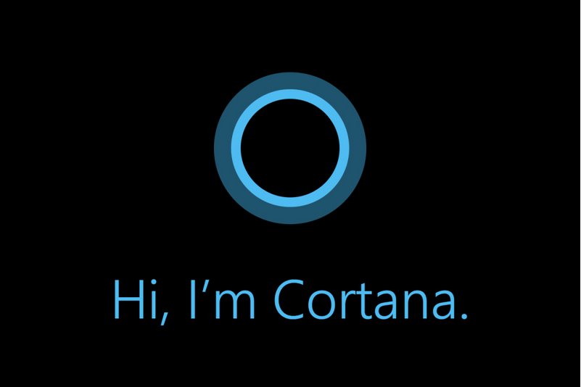
Literature Survey
Apple Siri (2011)
Performed basic tasks like setting alarms, sending texts, and providing weather updates.
Limited third-party app integration and struggled with diverse accents.
Microsoft Cortana (2014)
Focused on enhancing productivity with deep integration into Microsoft services like Outlook and Office.
Available on multiple platforms but faced slow response times and limited adoption outside the Microsoft ecosystem.
Google Now (2012)
Provided predictive assistance using Google’s data for contextually relevant information.
Raised privacy concerns due to heavy reliance on personal data and had limited third-party integration.

Slide 4
Existing System of the Project:
Limited Capabilities: Early voice assistants could not perform complex tasks.
Minimal Integration: Little to no integration with third-party apps and services.
Accent Understanding Issues: Struggled to accurately understand diverse accents and languages.
Slower Response Times: Voice recognition and responses were slower and less reliable.
Security Concerns: Higher security and privacy risks due to less advanced data protection.

Slide 5
Proposed System for Voice Assistant:
Enhanced Interaction: Understands and executes voice commands for better user interaction.
Multifunctional: Plays songs, provides current time, date, and weather updates.
Informative: Gives word definitions and Wikipedia summaries.
Web Access: Opens websites like YouTube, Instagram, and Google on command.
Additional Features: Can take screenshots and set timers.
Reliable Performance: Includes error handling for smooth operation and responses to unrecognized commands.

Slide 6


SYSTEM REQUIREMENTS
TOOLS & TECHNOLOGIES
OS : Windows 7 or above
RAM : 4GB or above
Hard Drive : 250 MB HDD
Processor : Intel Dual Core

Slide 7
Modules/Libraries Used:
Pyttsx3
Datetime
Speech Recognition.
Wikipedia
Web Browser
OS
Requests
PyAutoGui

Slide 8
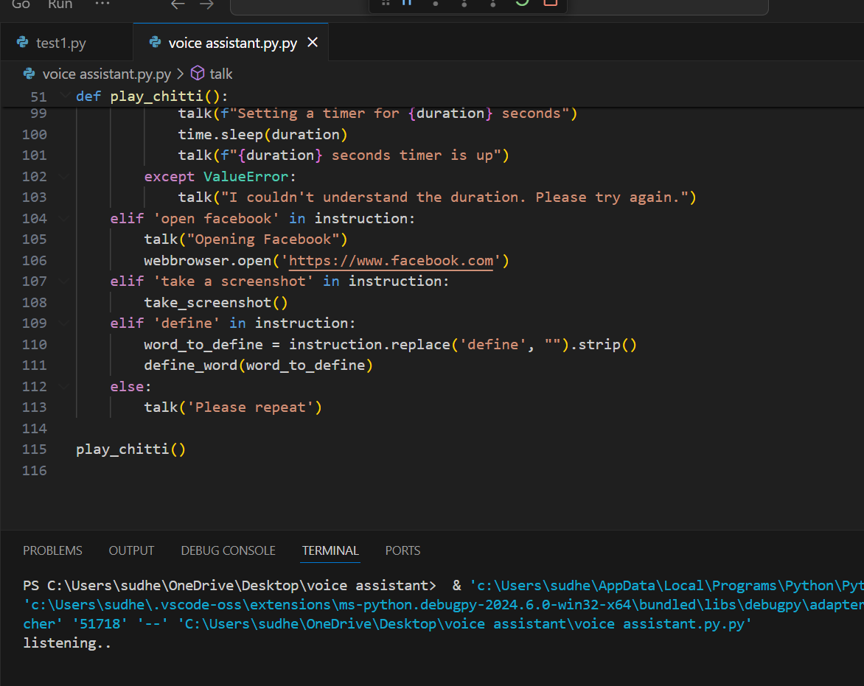
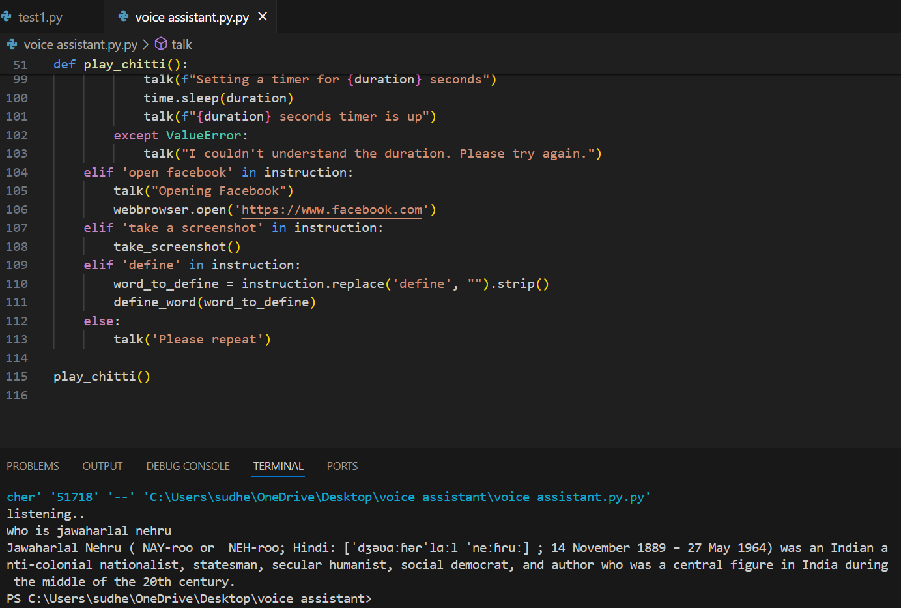
Execution:
Giving commands and getting output:

Slide 9
Conclusion
Service Automation: Automates various tasks like web searching and vocabulary help with single-line commands.
Server Assistant Goal: Aims to develop into a comprehensive server assistant, potentially replacing general server administration.
Smart Technology: Voice assistants are becoming more intelligent, offering greater convenience and functionality.
Seamless Integration: They are integrating into homes, workplaces, and personal devices, transforming daily life.
Future of Interaction: Represents a significant step forward in human-computer interaction.
Enhanced Accessibility: Makes technology more accessible and user-friendly.

